Slide 1
Chapter 7
Managing Risk

Slide 2
Risk Management Process
Risk
  Uncertain or chance events that planning can not overcome or control.
Risk Management
  A proactive attempt to recognize and manage internal events and external threats that affect the likelihood of a project’s success.
    What can go wrong (risk event).
    How to minimize the risk event’s impact (consequences).
    What can be done before an event occurs (anticipation).
    What to do when an event occurs (contingency plans).

Slide 3
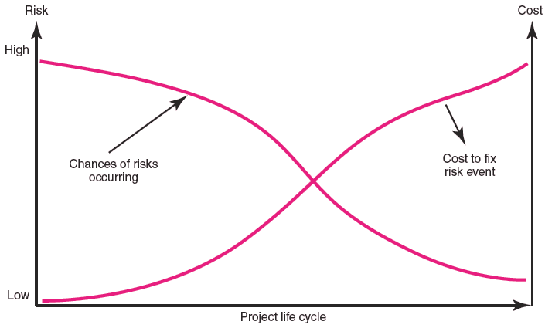
The Risk Event Graph
FIGURE 7.1

Slide 4
Risk Management’s Benefits
A proactive rather than reactive approach.
Reduces surprises and negative consequences.
Prepares the project manager to take advantage of appropriate risks.
Provides better control over the future.
Improves chances of reaching project performance objectives within budget and on time.

Slide 5
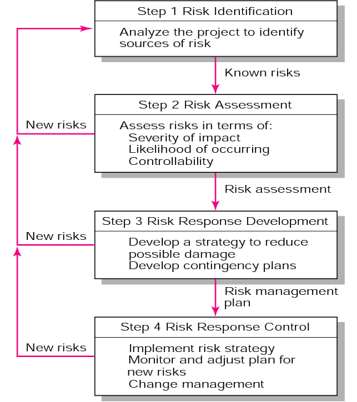
The Risk Management Process
FIGURE 7.2

Slide 6
Managing Risk
Step 1: Risk Identification
  Generate a list of possible risks through brainstorming, problem identification and risk profiling.
    Macro risks first, then specific events
Step 2: Risk assessment
  Scenario analysis
  Risk assessment matrix
  Failure Mode and Effects Analysis (FMEA)
  Probability analysis
    Decision trees, NPV, and PERT
  Semiquantitative scenario analysis

Slide 7
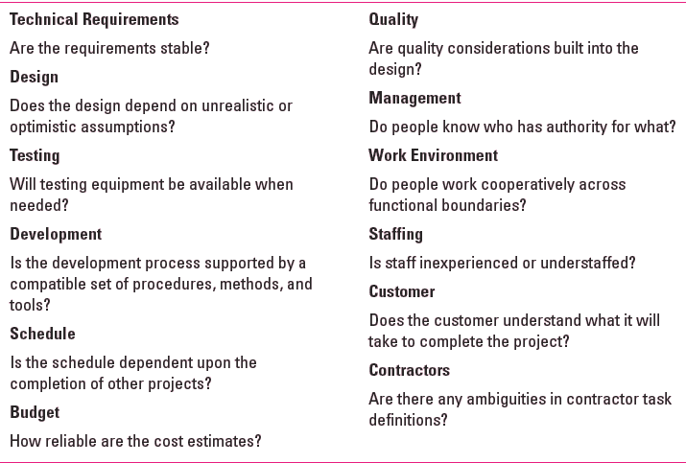
Partial Risk Profile for
Product Development Project
FIGURE 7.3

Slide 8
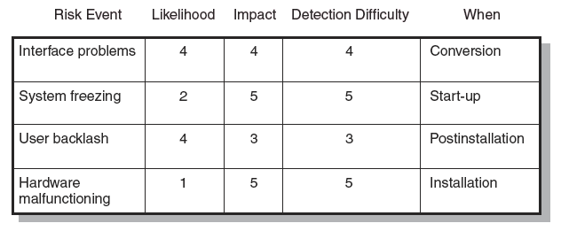
Risk Assessment Form
FIGURE 7.4

Slide 9
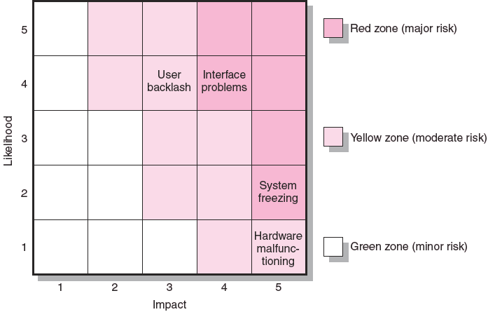
Risk Severity Matrix
FIGURE 7.5

Slide 10
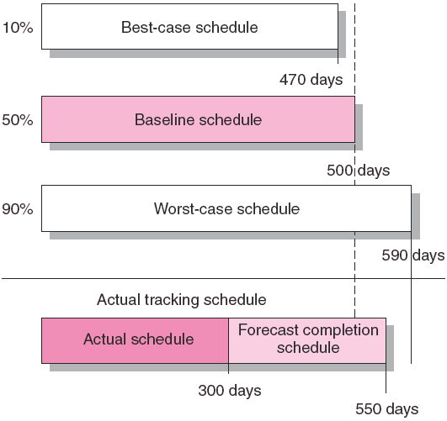
Risk Schedules
FIGURE 7.6

Slide 11
Managing Risk (cont’d)
Step 3: Risk Response Development
  Mitigating Risk
    Reducing the likelihood an adverse event will occur.
    Reducing impact of adverse event.
  Transferring Risk
    Paying a premium to pass the risk to another party.
  Avoiding Risk
    Changing the project plan to eliminate the risk or condition.
  Sharing Risk
    Allocating risk to different parties
  Retaining Risk
    Making a conscious decision to accept the risk.

Slide 12
Contingency Planning
Contingency Plan
  An alternative plan that will be used if a possible foreseen risk event actually occurs.
  A plan of actions that will reduce or mitigate the negative impact (consequences) of a risk event.
Risks of Not Having a Contingency Plan
  Having no plan may slow managerial response.
  Decisions made under pressure can be potentially dangerous and costly.

Slide 13
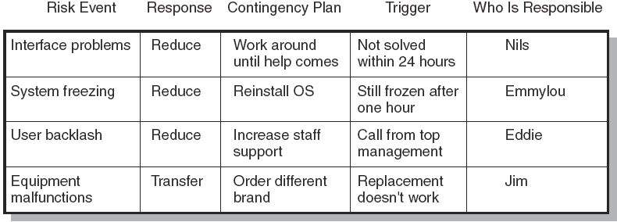
Risk Response Matrix
FIGURE 7.7

Slide 14
Risk and Contingency Planning
Technical Risks
  Backup strategies if chosen technology fails.
  Assessing whether technical uncertainties can be resolved.
Schedule Risks
  Use of slack increases the risk of a late project finish.
  Imposed duration dates (absolute project finish date)
  Compression of project schedules due to a shortened project duration date.

Slide 15
Risk and Contingency Planning (cont’d)
Costs Risks
  Time/cost dependency links: costs increase when problems take longer to solve than expected.
  Deciding to use the schedule to solve cash flow problems should be avoided.
  Price protection risks (a rise in input costs) increase if the duration of a project is increased.
Funding Risks
  Changes in the supply of funds for the project can dramatically affect the likelihood of implementation or successful completion of a project.

Slide 16
Contingency Funding and Time Buffers
Contingency Funds
  Funds to cover project risks—identified and unknown.
    Size of funds reflects overall risk of a project
  Budget reserves
    Are linked to the identified risks of specific work packages.
  Management reserves
    Are large funds to be used to cover major unforeseen risks (e.g., change in project scope) of the total project.
Time Buffers
  Amounts of time used to compensate for unplanned delays in the project schedule.

Slide 17
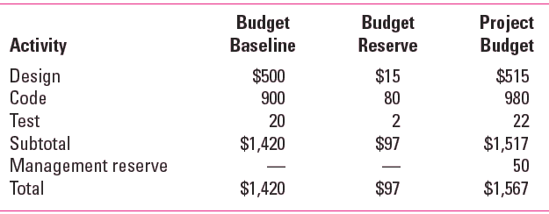
Contingency Fund Estimate (000s)
TABLE 7.1

Slide 18
Managing Risk (cont’d)
Step 4: Risk Response Control
  Risk control
    Execution of the risk response strategy
    Monitoring of triggering events
    Initiating contingency plans
    Watching for new risks
  Establishing a Change Management System
    Monitoring, tracking, and reporting risk
    Fostering an open organization environment
    Repeating risk identification/assessment exercises
    Assigning and documenting responsibility for managing risk

